Slide 1
Continuous Distributions (cont’d)
Uniform and Exponential
Sections 6.4-6.5
Statistics for Managers Using Microsoft Excel® 7e Copyright ©2014 Pearson Education, Inc.
Chap 6-1

Slide 2
Learning Objectives
Here, you learn:
To compute probabilities from the uniform distribution
To compute probabilities from the exponential distribution
Statistics for Managers Using Microsoft Excel® 7e Copyright ©2014 Pearson Education, Inc.
Chap 6-<number>

Slide 3
The Uniform Distribution
The uniform distribution is a probability distribution that has a constant density.
Therefore, it assigns equal probabilities for all possible outcomes of the random variable
Statistics for Managers Using Microsoft Excel® 7e Copyright ©2014 Pearson Education, Inc.
Chap 6-<number>

Slide 4
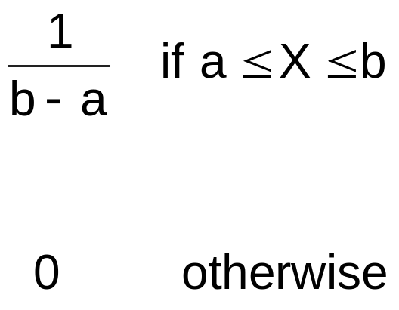
The Uniform Distribution
(continued)
The Continuous Uniform Distribution:
f(X) =
where
f(X) = value of the density function at any X value
a = minimum value of X
b = maximum value of X
Statistics for Managers Using Microsoft Excel® 7e Copyright ©2014 Pearson Education, Inc.
Chap 6-<number>

Slide 5
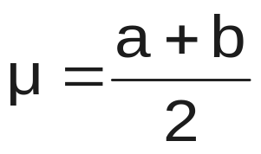
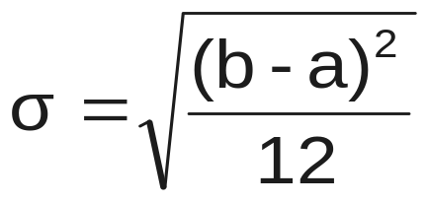
Properties of the
Uniform Distribution
The mean of a uniform distribution is
The standard deviation is
Statistics for Managers Using Microsoft Excel® 7e Copyright ©2014 Pearson Education, Inc.
Chap 6-<number>

Slide 6
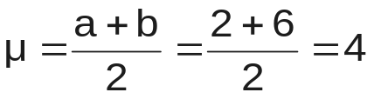
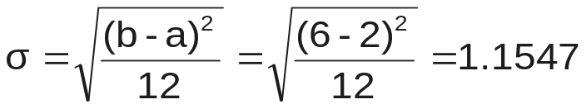
Uniform Distribution Example
Example: Uniform probability distribution
over the range 2 ≤ X ≤ 6:
1
f(X) = = 0.25 for 2 ≤ X ≤ 6
6 - 2
f(X)
0.25
2
6
X
Statistics for Managers Using Microsoft Excel® 7e Copyright ©2014 Pearson Education, Inc.
Chap 6-<number>

Slide 7
Uniform Distribution Example
(continued)
Example: Using the uniform probability distribution to find P(3 ≤ X ≤ 5):
P(3 ≤ X ≤ 5) = (Base)(Height) = (2)(0.25) = 0.5
f(X)
0.25
Recall: probability
equals the area
under the density
curve
2
3
4
5
6
X
Statistics for Managers Using Microsoft Excel® 7e Copyright ©2014 Pearson Education, Inc.
Chap 6-<number>

Slide 8
Examples
Suppose an airplane arrives at
a Uniform time between 5 pm and 6 pm.
P(arrives between 5:00 and 5:10)
= P(between 5:20 and 5:30)
That’s Uniform property.
Page 238, # 6.25
Statistics for Managers Using Microsoft Excel® 7e Copyright ©2014 Pearson Education, Inc.
Chap 5-<number>

Slide 9
The Exponential Distribution
Often used to model the length of time between two occurrences of an event (the time between arrivals)
  Examples:
    Time between trucks arriving at an unloading dock
    Time between transactions at an ATM Machine
    Time between phone calls to the main operator
  The number of arrivals is Poisson, the inter-arrival times are Exponential
Statistics for Managers Using Microsoft Excel® 7e Copyright ©2014 Pearson Education, Inc.
Chap 6-<number>

Slide 10
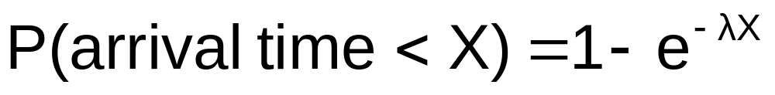

The Exponential Distribution
Defined by a single parameter, its mean λ (lambda)
The probability that an arrival time is less than some specified time X is
where e = mathematical constant approximated by 2.71828
λ = the population mean number of arrivals per unit
X = any value of the continuous variable where 0 < X <
Statistics for Managers Using Microsoft Excel® 7e Copyright ©2014 Pearson Education, Inc.
Chap 6-<number>

Slide 11
Excel commands
Exponential distribution
=EXPONDIST(x,lambda,cumulative)
Example: #6.34, page 240

